Slide 1
Computer Security
Dr. Van K. Nguyen
Privacy, Digital Right Managements & Electronic Commerce

Slide 2
Privacy
Privacy: the right to control who knows certain aspects about you, your communications, and your activities.
  In other words, you voluntarily choose who can know things about you and what those things are.
Privacy is controlled disclosure:
  The subject chooses what personal data to give out and to whom.
  After disclosing something, a subject relinquishes much control to the receiver.
What data are sensitive is at the discretion of the subject: people consider different things sensitive.
  Why a person considers something sensitive is less important than that it is.

Slide 3
Privacy
Individuals, informal groups, and formal organizations all have things they consider private.
Privacy has a cost: choosing not to give out certain data may limit other benefits

Slide 4
Dimensions of privacy
By Rezgui et al.
Information collection: Data are collected only with knowledge and explicit consent.
Information usage: Data are used only for certain specified purposes.
Information retention: Data are retained for only a set period of time.
Information disclosure: Data are disclosed to only an authorized set of people.
Information security: Appropriate mechanisms are used to ensure the protection of the data.
Access control: All modes of access to all forms of collected data are controlled.
Monitoring: Logs are maintained showing all accesses to data.
Policy changes: Less restrictive policies are never applied after-the-fact to already obtained data.

Slide 5
A privacy controversy: key escrow
Key escrow system allows authorized third party to recover key
  Goal: provide this without weakening cryptosystem
  Very controversial!
Useful when:
  keys belong to roles, such as system operator, rather than individuals
  Business: recovery of backup keys
  Law enforcement: recovery of keys that authorized parties require access to

Slide 6
A privacy controversy: anonymity in e-payment systems
We want a e-payment method which can imitate the use of cash.
This is possible technically but would not be accepted by law.
  D. Chaum’s Digtial Cash system provided perfect anonymity in spending e-coins: spenders are absolutely untraceable if do not double-spend
  However such perfect anonymity would provoke perfect crimes:
    Blackmailing
    Money laundering
So, anonymity of spending is not allowable: spenders must be traceable if law-enforcers require with court approval.

Slide 7
Information Hiding
Information hiding: technologies intentionally hiding certain information to multimedia content.
  Conventionally by cryptography but just using encryption is not adequate
  Therefore, IH has come to help with security of multimedia contents.
There are several ways to protect digital content
  Encryption: encrypt and share decryption key between the author and the observer.
    limit of use: the observer must have key ➔ against free distribution and circulation - not desirable to the author.
  Digital Watermarking: only embeds watermark information to the content
    Anyone without watermark extraction key can still observe but can’t remove the DM

Slide 8

Basic model of digital watermarking
Content Provider
User of the Content
Distributed key
Watermark
information
ID of author
ID of buyer
Check for
the watermark
Embedding key
Illegal use
Illegal transaction
Watermark
information
ID of author
ID of buyer
Check for
the watermark
Watermark
information
ID of author
ID of buyer
Illegal content
with watermark
Detection of illegal user
Claim copyright
Not a technology to protect from illegal copy,
but a technology which works as
deterrent against illegal use
Deterrence against
illegal use

Slide 9
Steganography
Steganography
  conceals a hidden message to a content
  but the existence of a message is kept secret
Secret key model of steganography (key kA = kB): key sharing is one of the problem for secret communication.
public key model (kA <> kB) : key sharing isn’t an issue.
For the purpose of digital watermarking, content should not be encrypted or scrambled.
  Digital watermark is often embedded imperceptibly to human receptors
  The human visual system (HVS) model is often used.
  Perceptible watermark are sometimes used, but it limits the use of the images.
Therefore, main concern in this research area has focused on imperceptible watermark.

Slide 10
Basic model of steganography
Sender A
Receiver B
Internet
Environment
Cover object
Embedded object
Embedded
object
Plain Text
p
Embedding
Procedure
h
Extracting
Procedure
h
Plain Text
P’
Key kA
Key kB
Attackers tries
to tap
or to alter
the object

Slide 11
Purpose of Digital Rights Management (DRM)
Digital Rights Management (DRM) technology
  controls the distribution of the digital contents
  limits the access of the digital contents
  i.e. used against illegal use of the digital contents.
There are several classification of DRM but mainly
  copy control methods: control or limit a certain copying procedures
  access control methods: control or limit accessing the content

Slide 12


Copy control and access control in DRM
Copy control: can be between “no copy at all” and some quota on the number of copies can be produced.
There are two control structures: copy control information type and network authentication type (by its administration method of the copying information).
Original
Copy
Access
Copy control
Access control

Slide 13
Example of network authentication model for copy control
Playing and copying device
Authentication Server
Original
Copy
Authentication
DB
Copy Control
Copy or not to copy
Request for the
rights to copy

Slide 14
Access control
Access control is a method to control the access procedure of the target content
  Generally, the content is encrypted and only the proper user will have the decryption key to decrypt the content and is available to access to the content.
  The distribution of this decryption key could be selected from various methods by the media type.
  Those distribution method can be classified as media type, broadcasting type and network type.
Media type: the content is distributed by the form of physical media like DVD and CD.
  Encrypted content is stored in the media with decryption key and access control information.

Slide 15
Media access control
Content Protection for Prerecorded Media (CPPM) and Content Protection for Recordable Media (CPRM) uses both copy control method and media type of access control for digital rights management.
Keys are called Media Key Block (MKB), media ID, encrypted title key which are stored in the media.
The device ID configured in the playing device of the media is used for decryption of the content.
Because MKB and media ID are stored in the region inaccessible to the playing device, user cannot decrypt the content when the content is copied to another media or hard disk drive.
If the decryption key is somehow illegally distributed or out flowed, we can avoid and protect from illegal access of the content with illegal device by changing the MKB to a new one.

Slide 16



CPPM and CPRM
DVD Recorder
DVD Player
Device Key
Device Key
MKB
Generate
Generate
Media Key
Media Key
Generate
Generate
MUK
Media ID
MUK
Encrypt
Decrypt
Title Key
Encrypted Title Key
Title Key
Encrypt
Decrypt
Content
Content
Encrypted Content
MKB: Media Key Block MUK: Media Unique Key

Slide 17
Basic model of network type access control
Packager
License Server
Key
Original Content
License DB
License Request
License Send
User
Encrypted Content
Media Server
Content Request
Content Send

Slide 18

Digital watermarking used in network type access control model
Packager
Copyright Management Server
Embedding
Key
Verify watermark information
Original Content
Extracting Key
Watermark
Watermark DB
License Server
Watermark Embedded Content
Key
License Request
License Send
User
License DB
Media Server
Content Request
Encrypted Content
Content Send

Slide 19
Technologies in information hiding
Information Security
Protection technologies
for computer systems
Protection technologies
for digital information
Cryptography
Information Hiding/Retrieval
Digital Fingerprinting
Digital Watermarking
Steganography

Slide 20
Electronic Commerce
E-commerce can be defined as any transaction involving some exchange of value over a communication network.
This broad definition includes:
  Business-to-business transactions, such as EDI (electronic data interchange) ➔ e-business
  Customer-to-business transactions, e.g. online shops on the Web
    Customer-to-financial institution: e-banking
  Customer-to-customer transactions, e.g. transfer of value between personal account/ electronic wallets
  Customers/businesses-to-government (public administration transactions), such as filing of electronic tax returns ➔ e-government

Slide 21
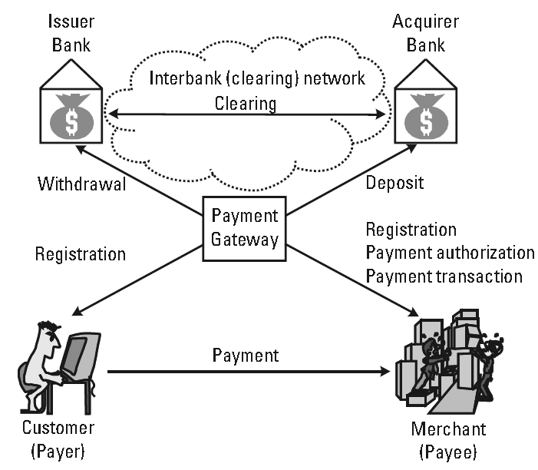
Electronic Payment
A typical e-payment system: a customer C and a merchant M first register with the corresponding payment service provider which runs a payment gateway G
Notes:
Payment gateway G is reachable from both the public network (e.g., the Internet) and from a private interbank clearing network.
C and M each have a bank account at a bank connected to the clearing network. The customer’s bank also called issuer bank. The acquirer bank acquires payment records from the merchants.

Slide 22
The payment protocol
Assume: C chooses to pay with debit/credit card.
When purchasing something, C pays some money to M
  Before supplying , M asks G to authorize C
  G contacts C’s issuer bank to check.
If everything OK,
  Money is withdrawn (or debited) from the C’s account and deposited in (credited to) M’s account.
  G notifies of the successful payment to M
  M can supply the ordered items to C.
In some cases (low-cost values), items can be delivered before the actual payment authorization.

Slide 23
Online vs. Offline
Off-line system: during a payment transaction C and M are both off-line to their respective banks
  M can’t check with C’s issuer bank so M cannot be sure if obtain the full money or not
  It is difficult to prevent C from spending more money than he actually possesses.
  So, most proposed Internet payment systems are online
Online system: online presence of an authorization server
  a part of the issuer or the acquirer bank.
Clearly, an online system requires more communication, but it is more secure than off-line systems.

Slide 24
Debit vs. Credit
An electronic payment system can be credit based or debit based
In a credit based system (e.g., credit cards) the charges are posted to C' account and C later pays the accumulated amounts to the payment service.
In a debit-based system (e.g., debit cards, checks) C’s account is debited immediately during the transaction.

Slide 25
Macro Versus Micro
Macropayment systems: relatively large amounts of money can be exchanged (electronically)
Micropayment systems: designed for small payments (under a dollar)
The macro vs. micro should be taken seriously into the design of a e-payment system
It makes no sense to implement expensive security protocols to protect e-coins of low value like a few cent:
  Better try to discourage or prevent large-scale attacks in which huge numbers of coins can be forged or stolen.

Slide 26
Payment Instruments
Two main groups: cash-like and check-like payment systems
Cash-like: C withdraws a certain amount of money from his account (e-coins) and uses that money whenever he wants to make a payment.
Check-like: the money stays in C’s account until a purchase is made.
  C sends a payment order to M: the money will be withdrawn from C’s account and deposited in M’s account.
The payment order can be a piece of paper (e.g., a bank-transfer slip) or an e-document (e.g., an e-check)

Slide 27
Electronic money
Electronic representation of traditional money
E-coins are “minted” (generated) by brokers. If C wants to buy e-coins, he contacts a broker, orders a certain amount of coins, and pays with “real” money
C can then make purchases from any merchant that accept the digital coins of that broker
M can redeem at the broker’s the coins obtained from C
  The broker takes back the coins and credits the M’s account with “real” money

Slide 28
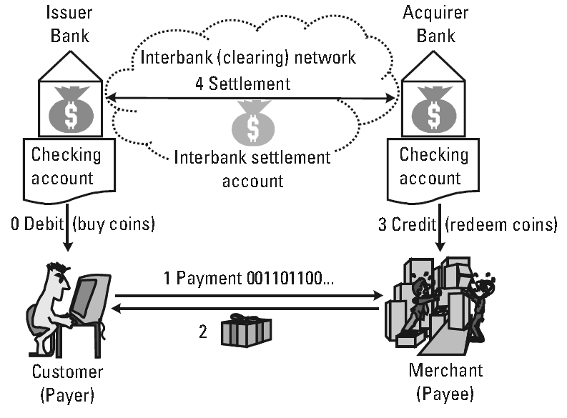
Electronic money

Slide 29
Chaum’s digital cash system
Very well constructed technically
  Double-spenders are fully traceable
    Cut-and-choose technique
  Perfect anonymity if no double-spending
    Invention of blind singnature
Not practical: suffering to perfect crimes
  Blackmailing
  Money Laundering

